Slide 1
Analytical Method for First Order Rayleigh Scattering in CBCT Application
PHYS 4250 Project report
Yutong Zhao

Slide 2
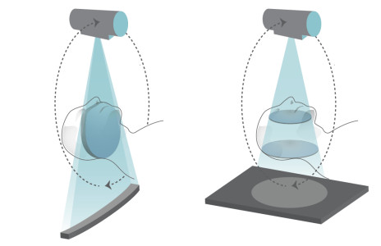
Computed Tomography (CT) & Cone beam CT (CBCT)
CT: 2-D Picture CBCT:3-D Structure
Notes:
Introduce CT and Cone beam CT.
CT is widely used in medical physics.
CT ‘s fundamental principle
CBCT can save time and increase efficiency

Slide 3
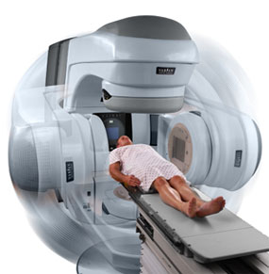
Medical Imaging System
Application:
Image Guided Radiotherapy
(figure)
Tumor & Trauma Diagnosis
Nondestructive testing
Notes:
Some application of CBCT.
1,2,3
Our focus is on Image guided radiotherapy

Slide 4
Motivation
Scatter correction in CBCT provide better anatomical image quality.
Notes:
The purpose of this project. ----- Calculate scatter and improve image quality.

Slide 5
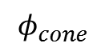
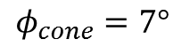
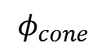
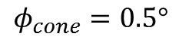
Current problem
X-ray source
Scattering induced noise[1]
Campton scattering
(solved)
Rayleigh scattering
(remain to be solved)
$$φ_{cone}$$
“Lower Scatter condition”
Water
$$φ_{cone}=0.5°$$
X-ray source
$$φ_{cone}$$
“Higher Scatter condition”
Water
$$φ_{cone}=7°$$
Notes:
Figure:
1. The darker of the image, the low resolution we have.
2. The larger the divergence angle, the low resolution in center.
Large angle – larger scan volume
Scattering contains two parts. --------concentrate on Rayleigh.

Slide 6
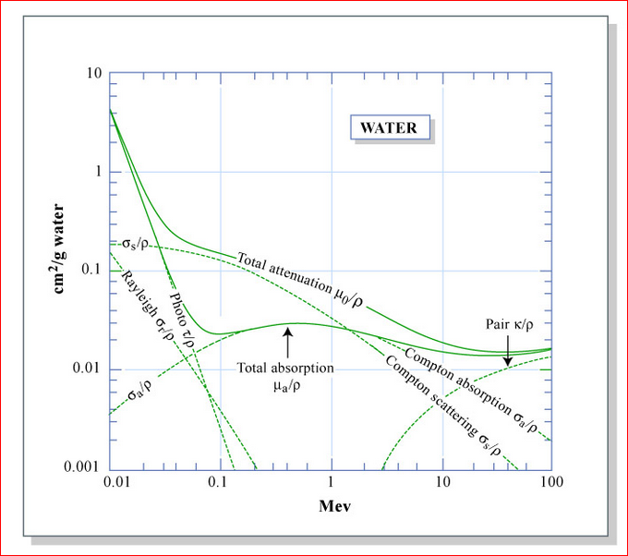
Radiation Interaction
KV-range
Rayleigh scattering
Energy range
Notes:
Figure:
The photon interaction in matter. (water)
Rayleigh scattering range ---- X-ray source
Don’t forget attenuation (latter)

Slide 7
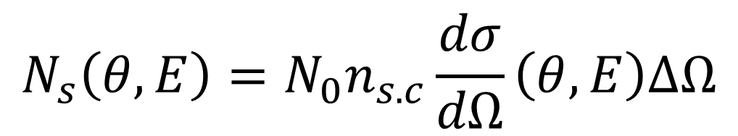
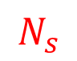
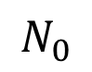
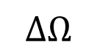
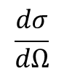
Rayleigh Scattering[2]
$$ΔΩ$$
$$\frac{dσ}{dΩ}$$
$$N_{s}$$
Scattering theory:
$$N_{0}$$
$$n_{s.c}=number density of scattering cetners$$
$$N_{s}\left(θ,E\right)=N_{0}n_{s.c}\frac{dσ}{dΩ}\left(θ,E\right)ΔΩ$$
Detected Signal
X-ray Intensity
Differential
Cross section
Solid angle
of detector
Notes:
N_s expected signal

Slide 8
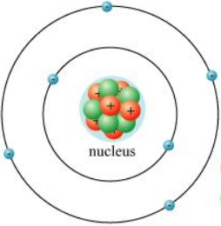
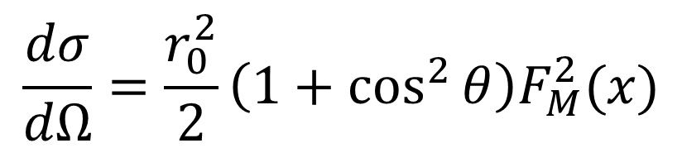
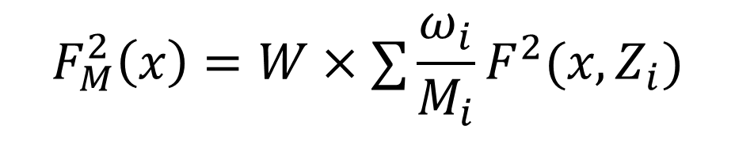
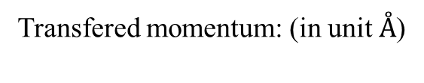
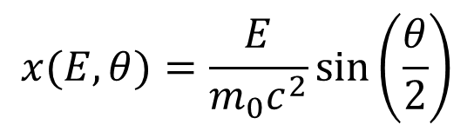
Differential Cross Section
Transfered momentum: (in unit $Å$)
$$x(E,θ)=\frac{E}{m_{0}c^{2}}\sin\left(\frac{θ}{2}\right)$$
$$\frac{dσ}{dΩ}=\frac{r_{0}^{2}}{2}\left(1+\cos^{2}{θ}\right)F_{M}^{2}(x)$$
Constant
Material Form Factors[2]
$$F_{M}^{2}\left(x\right)=W×∑\frac{ω_{i}}{M_{i}}F^{2}(x,Z_{i})$$
Chemical composite
Atomic Form Factors [3]
Notes:
r0------- classical electron radius
W------ molecule weight
Wi------ mass fraction of i
Mi------ atomic mass of i
Atomic form factors ---- describe the shape of atom according to atomic number

Slide 9
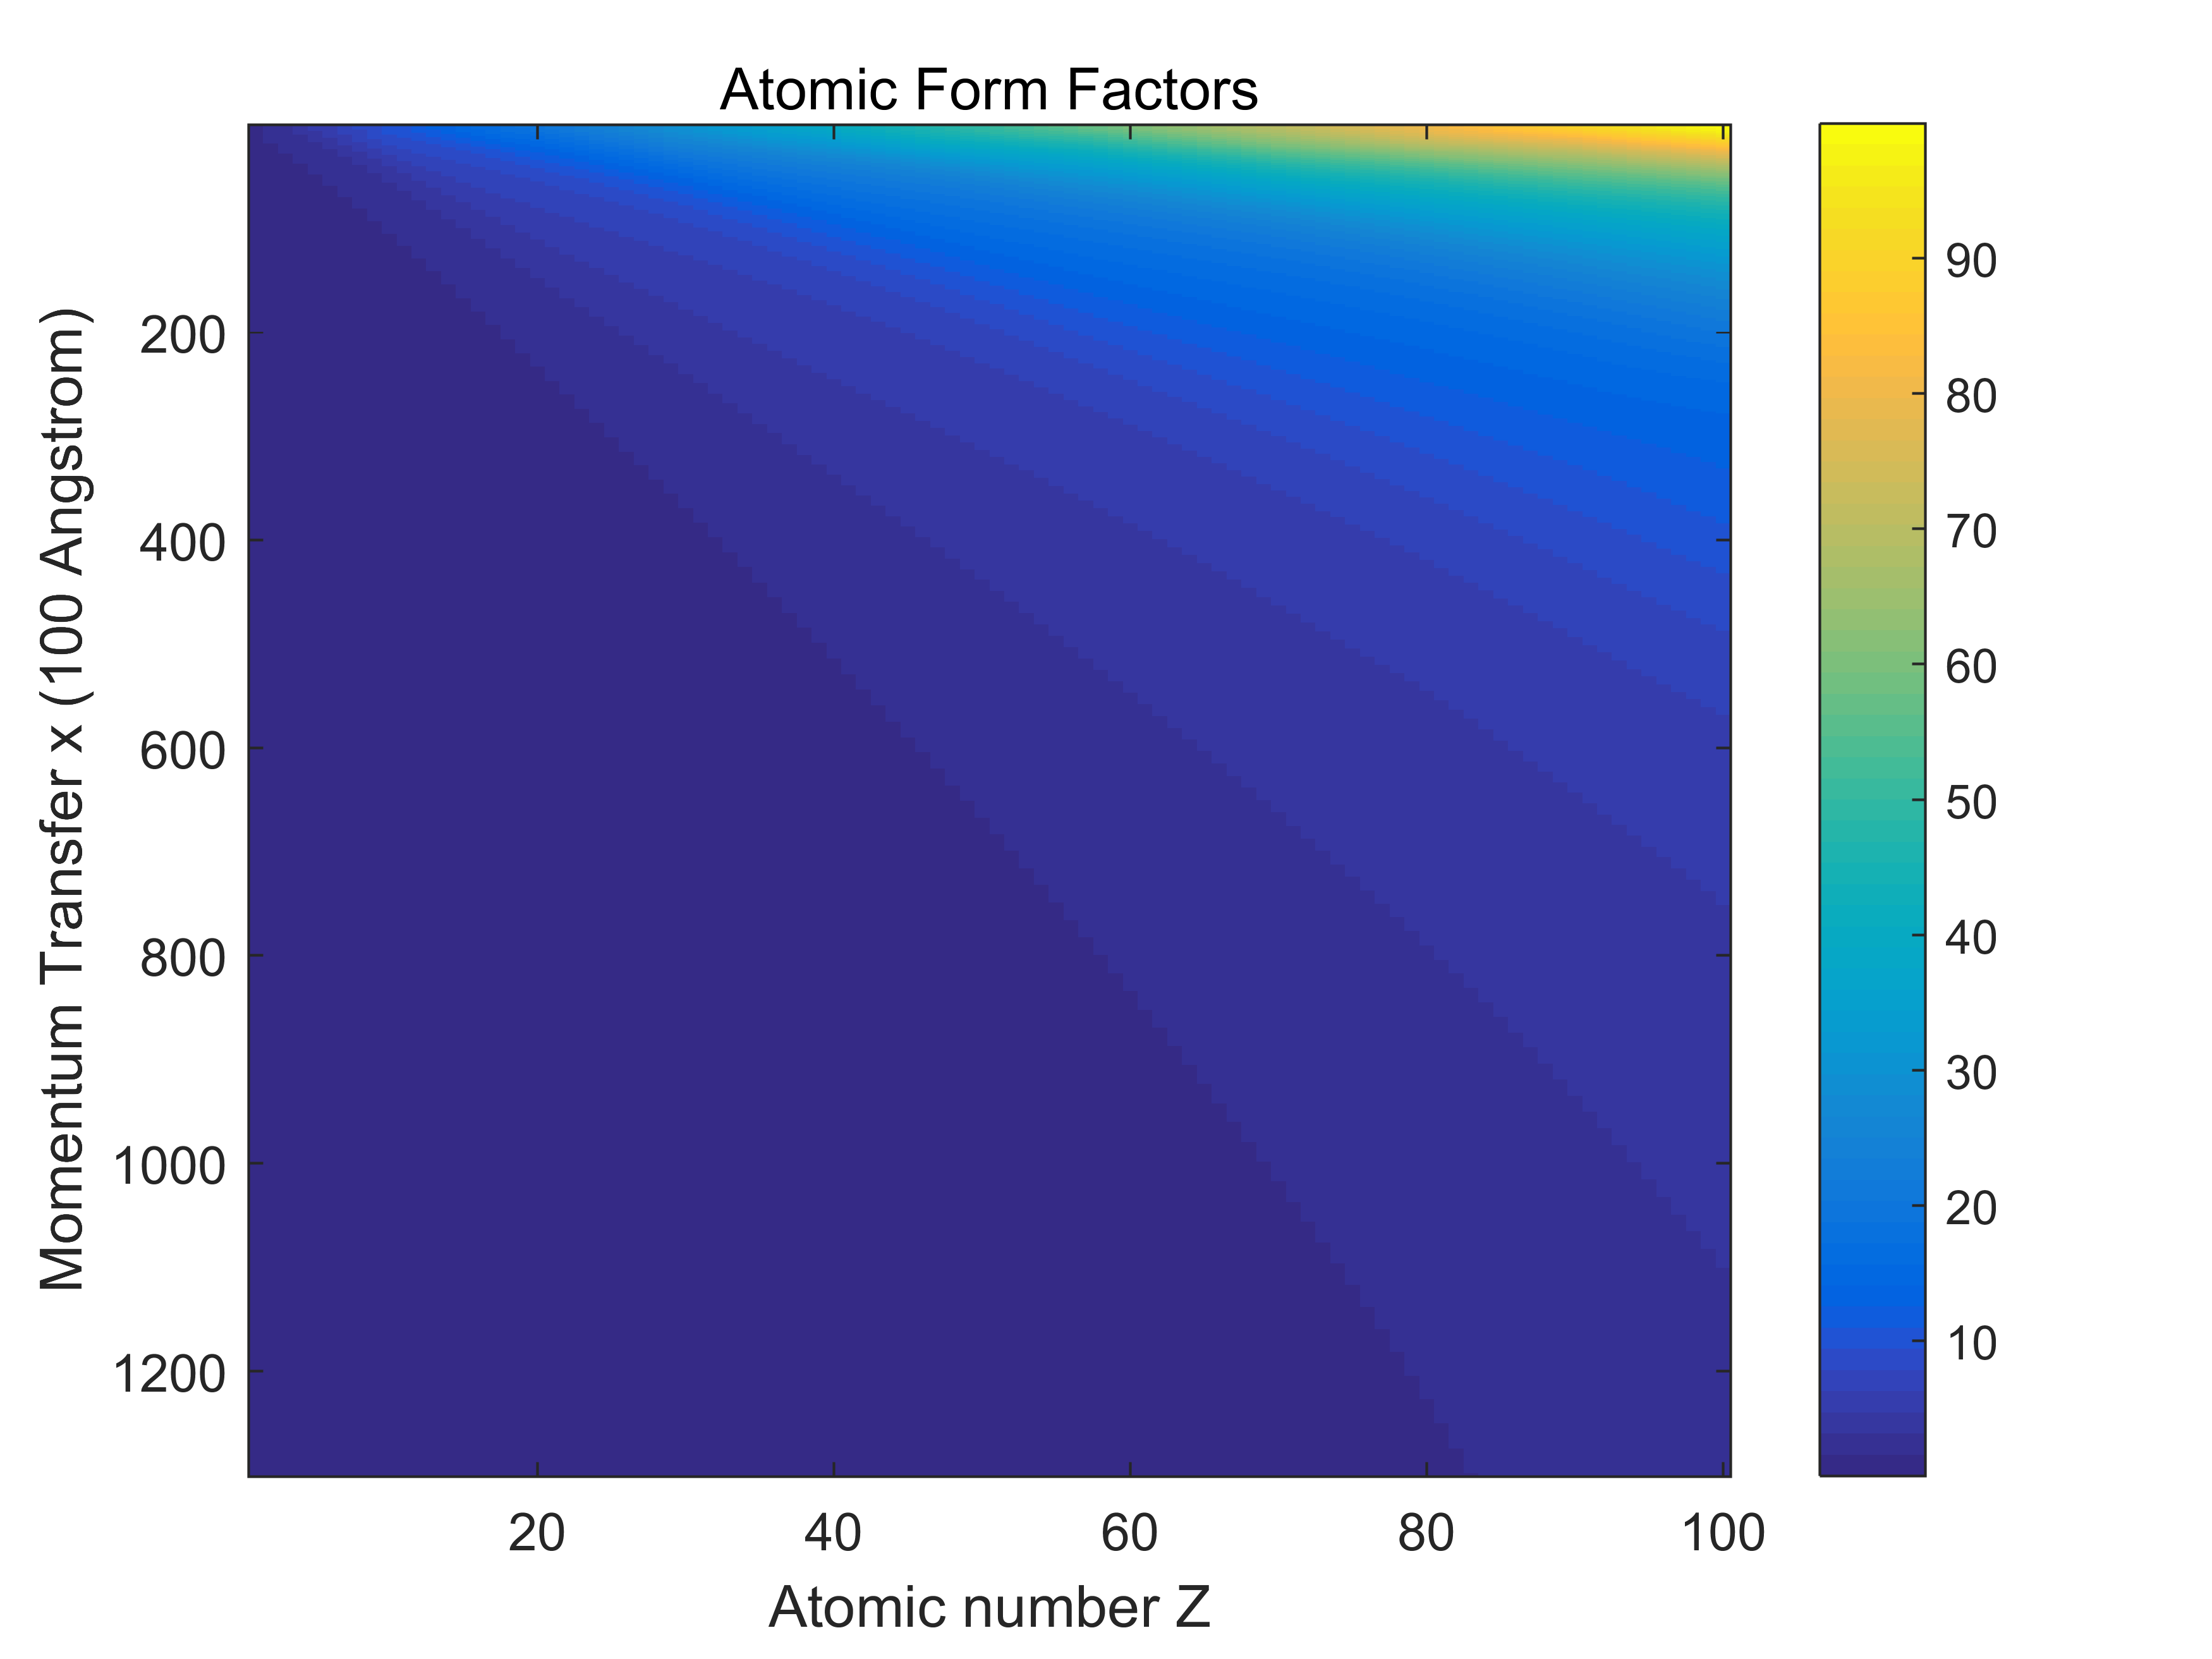
Atomic Form Factors
Notes:
Spline Interplotation
Size of atoms
With atomic number increase, shape increase

Slide 10
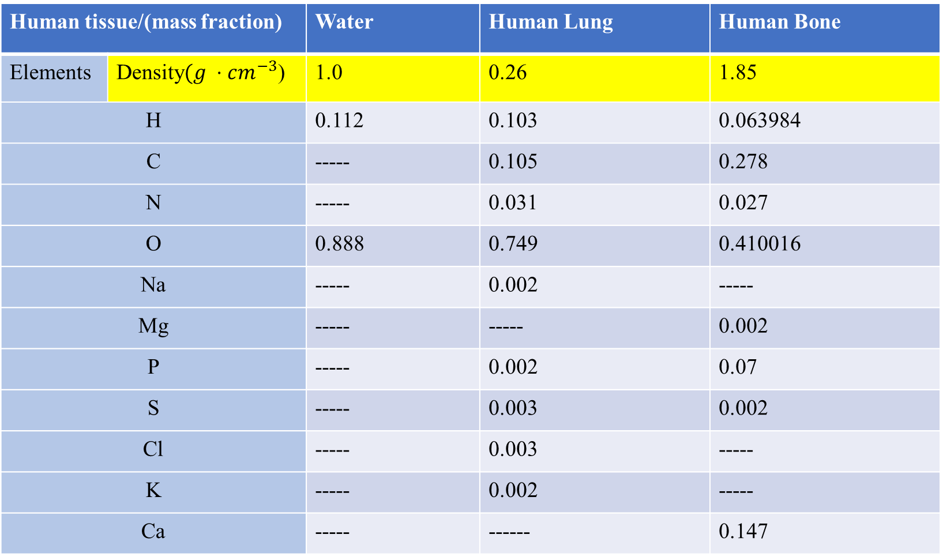
Material Chemical Formulas (EGS data)
Human tissue/(mass fraction) |  | Water | Human Lung | Human Bone
Elements | Density$(g ⋅cm^{−3}$) | 1.0 | 0.26 | 1.85
H |  | 0.112 | 0.103 | 0.063984
C |  | ----- | 0.105 | 0.278
N |  | ----- | 0.031 | 0.027
O |  | 0.888 | 0.749 | 0.410016
Na |  | ----- | 0.002 | -----
Mg |  | ----- | ----- | 0.002
P |  | ----- | 0.002 | 0.07
S |  | ----- | 0.003 | 0.002
Cl |  | ----- | 0.003 | -----
K |  | ----- | 0.002 | -----
Ca |  | ----- | ------ | 0.147
Notes:
Water & lung very close , different density
Bone --density & composite

Slide 11
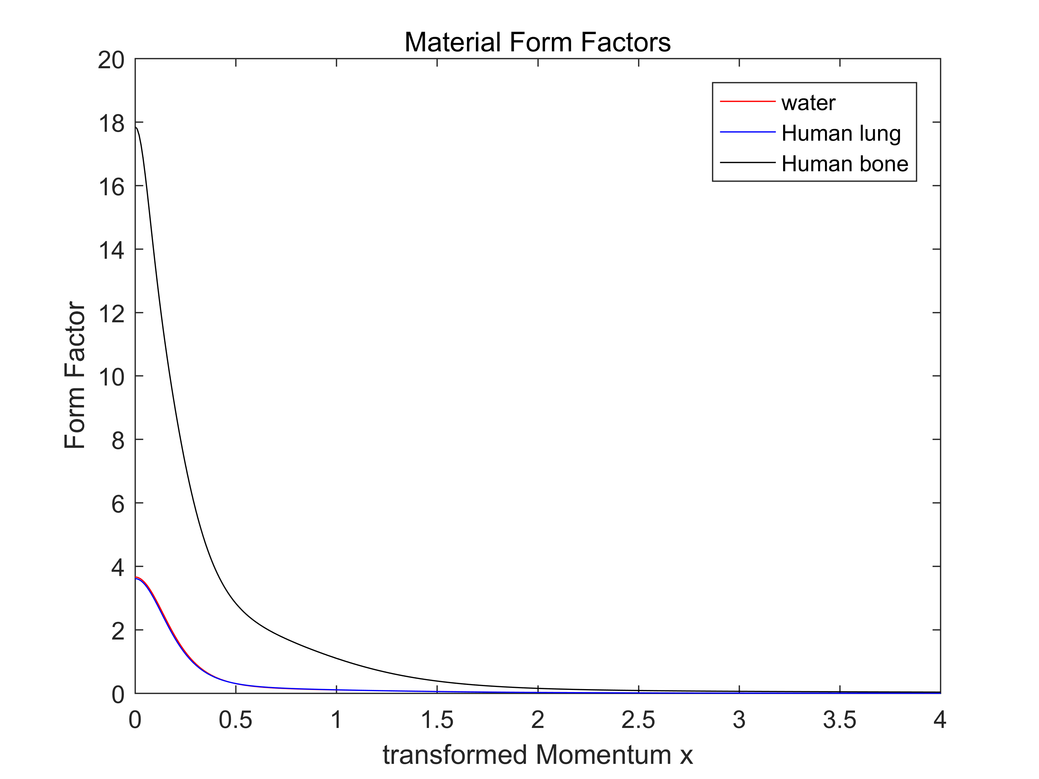
Form Factor interpolation
Database #1
Notes:
Water & lung –> very close
Bone --→ calcium influence

Slide 12
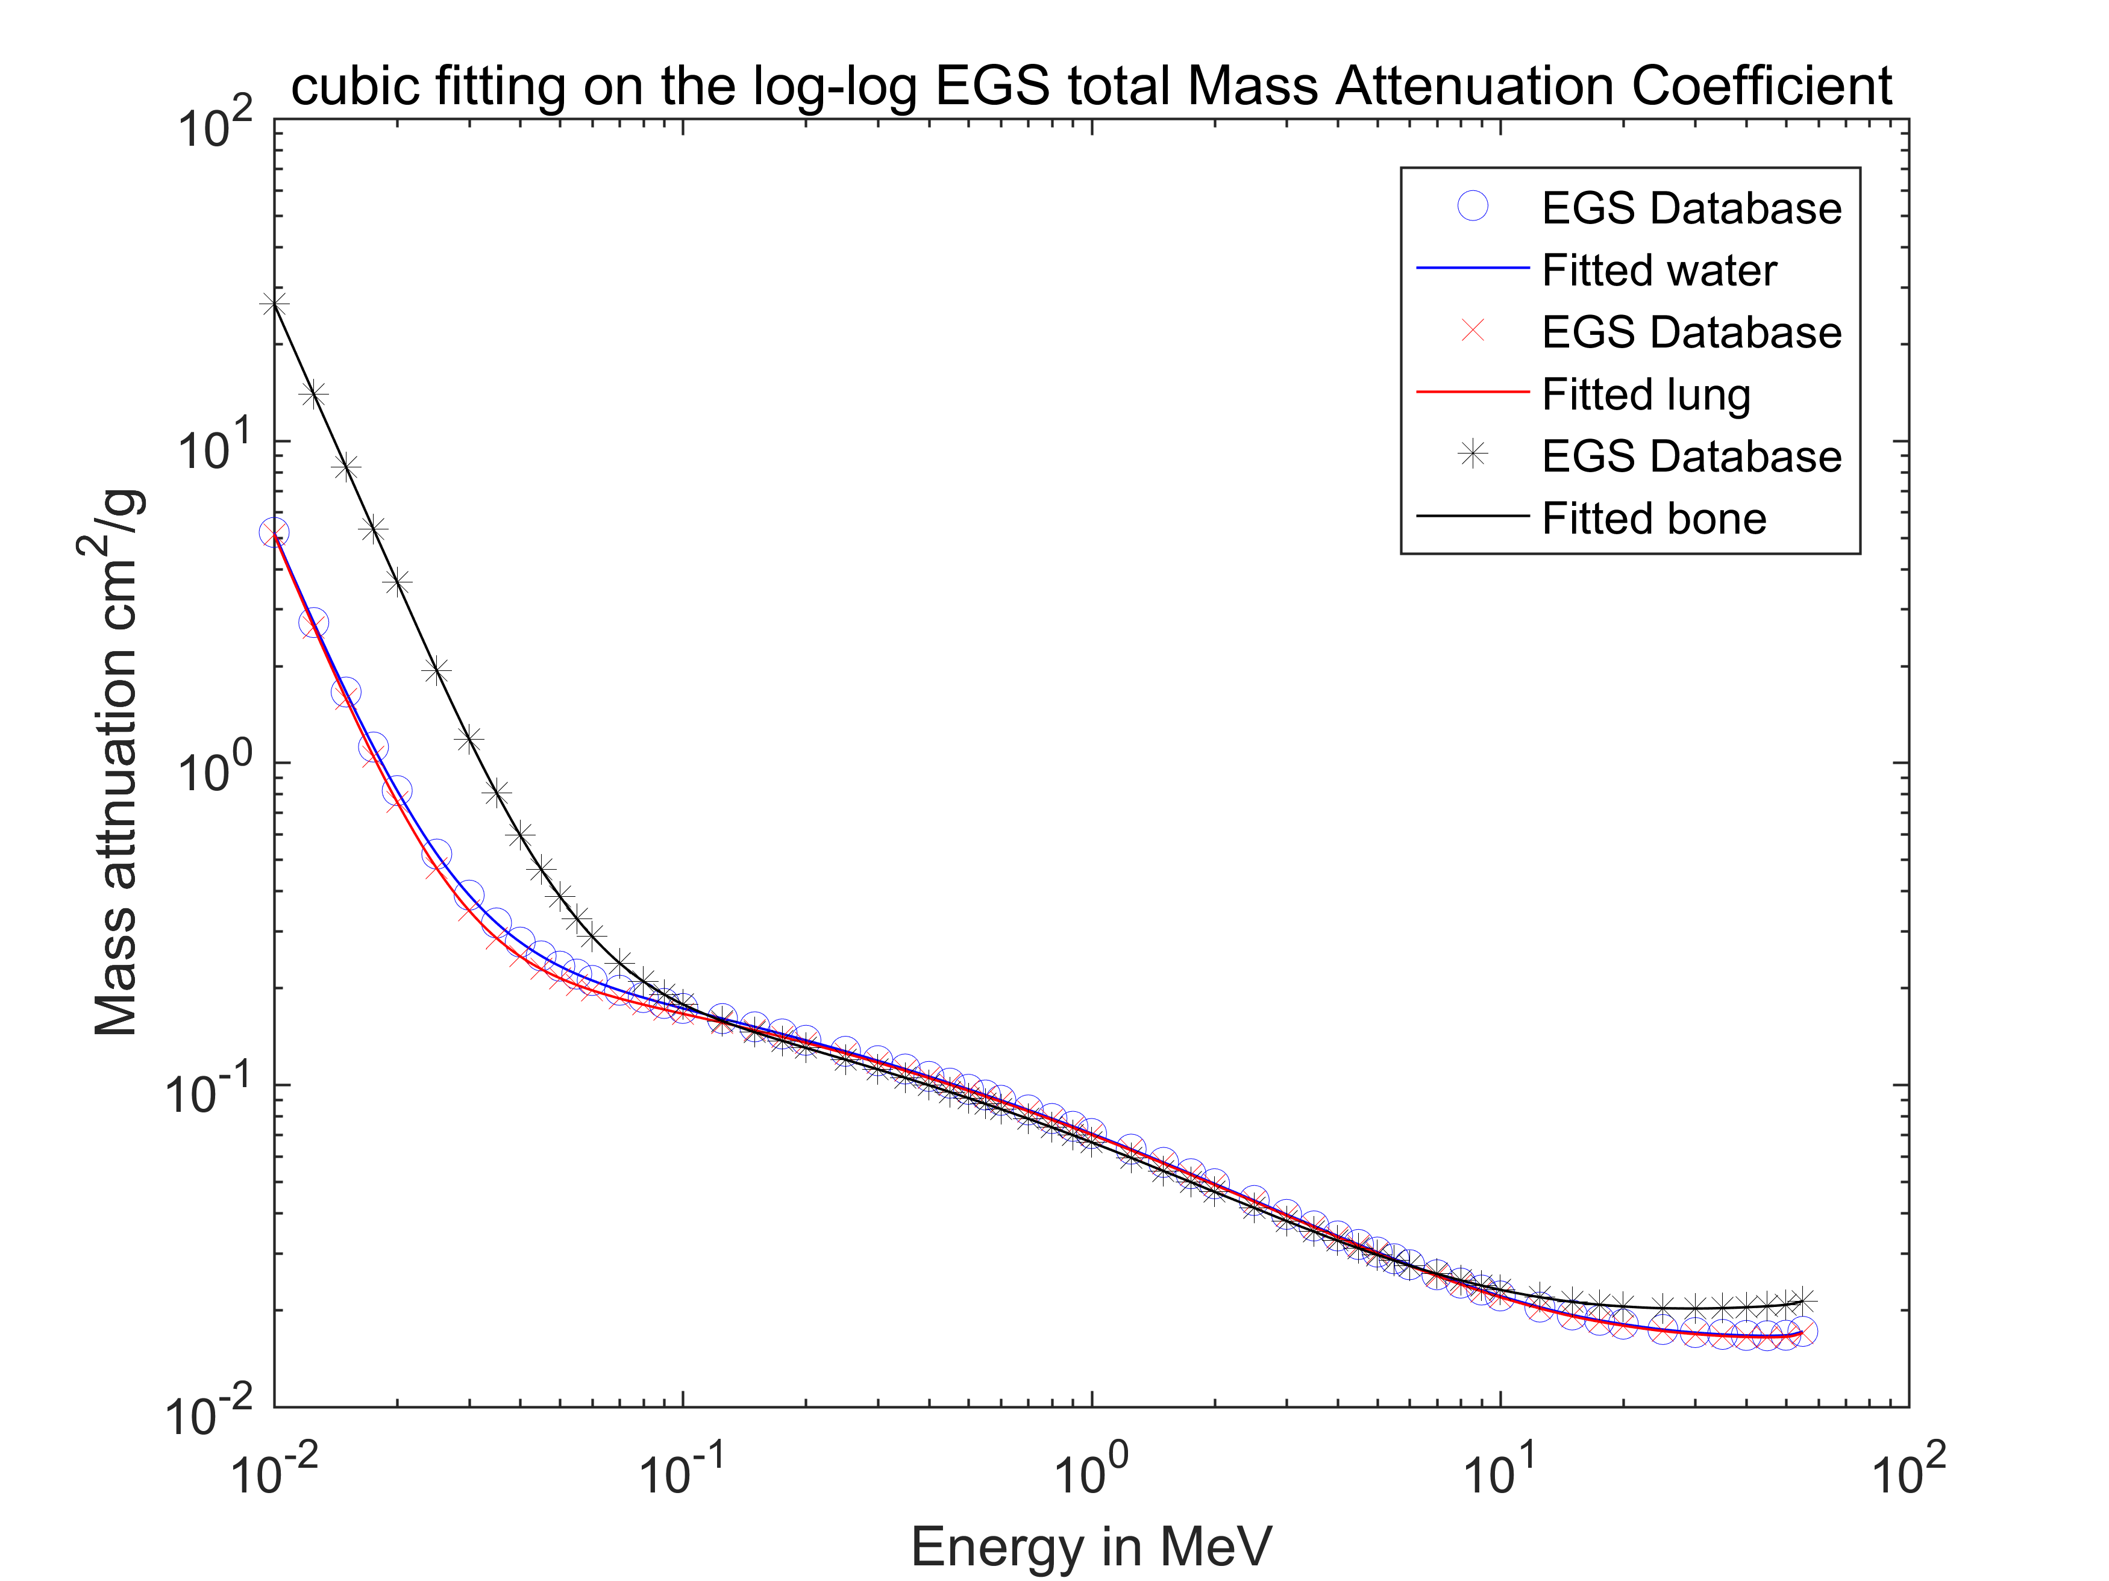
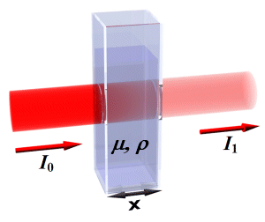
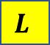
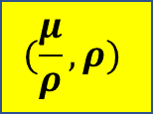
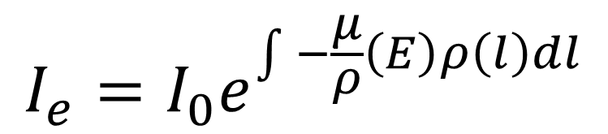
Mass attenuation coefficients and interpolation
KV range
Database #2
$$(\frac{μ}{ρ}, ρ)$$
N_{t}
N₀
$$L$$
$$I_{e}=I_{0}e^{\int{ }−\frac{μ}{ρ}\left(E\right)ρ\left(l\right)dl}$$
Notes:
Coherent result:
Water & lung --- close
Bone --- different
All the database we need

Slide 13
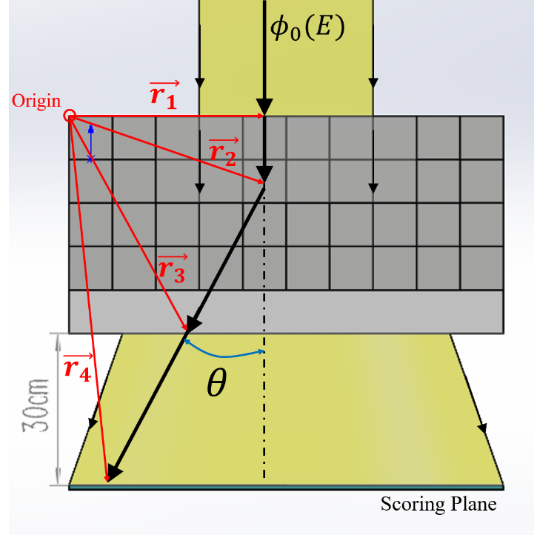
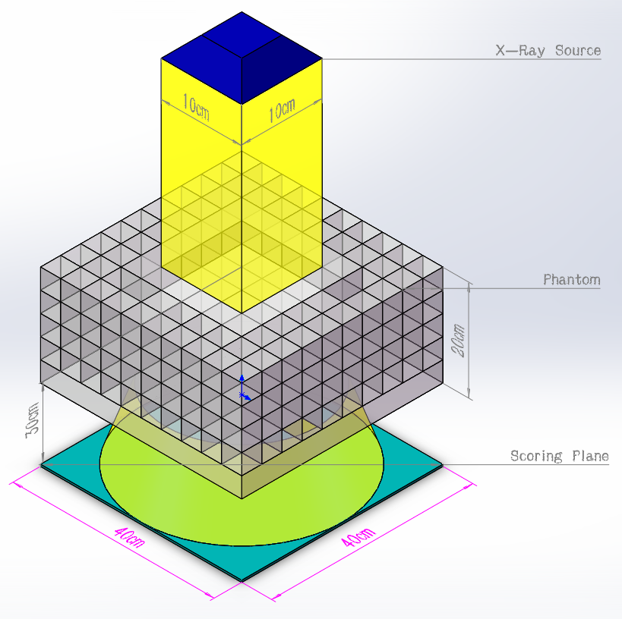
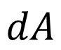
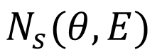
Simulation Setup (Parallel beam Geometry)
Interaction site
$$dA$$
$$N_{s}(θ,E)$$
Notes:
How we determine \theta , trace, and solid angle

Slide 14
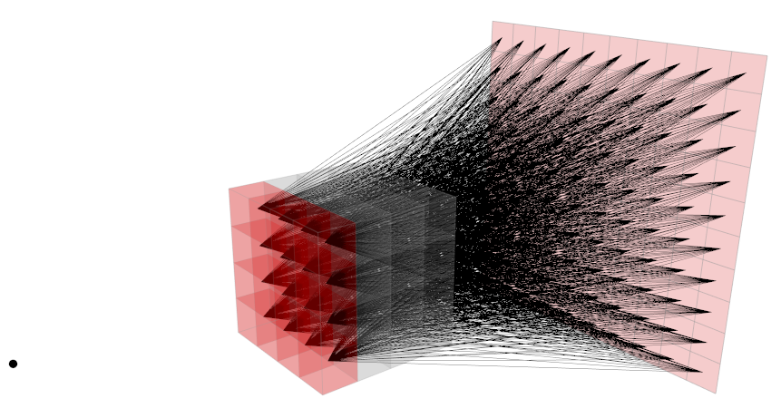
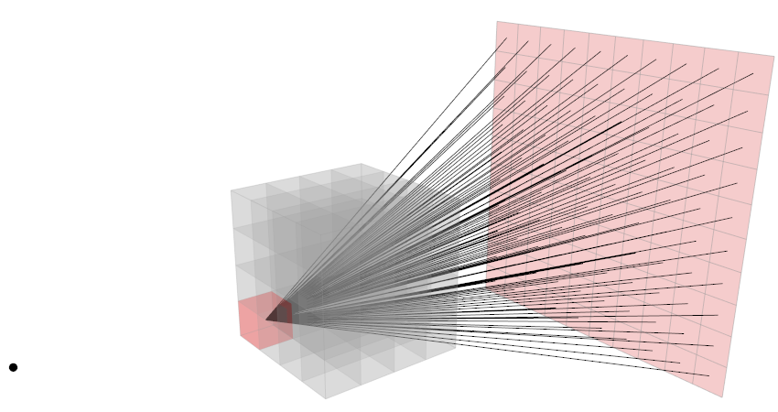
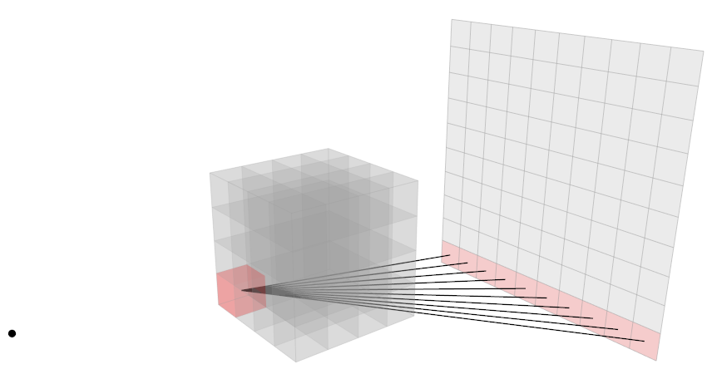
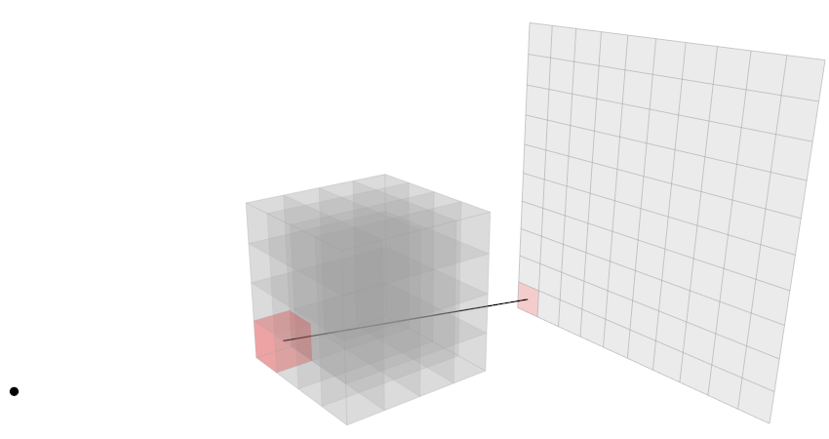
Simulation setup
Notes:
Sweep Beam covered volume

Slide 15
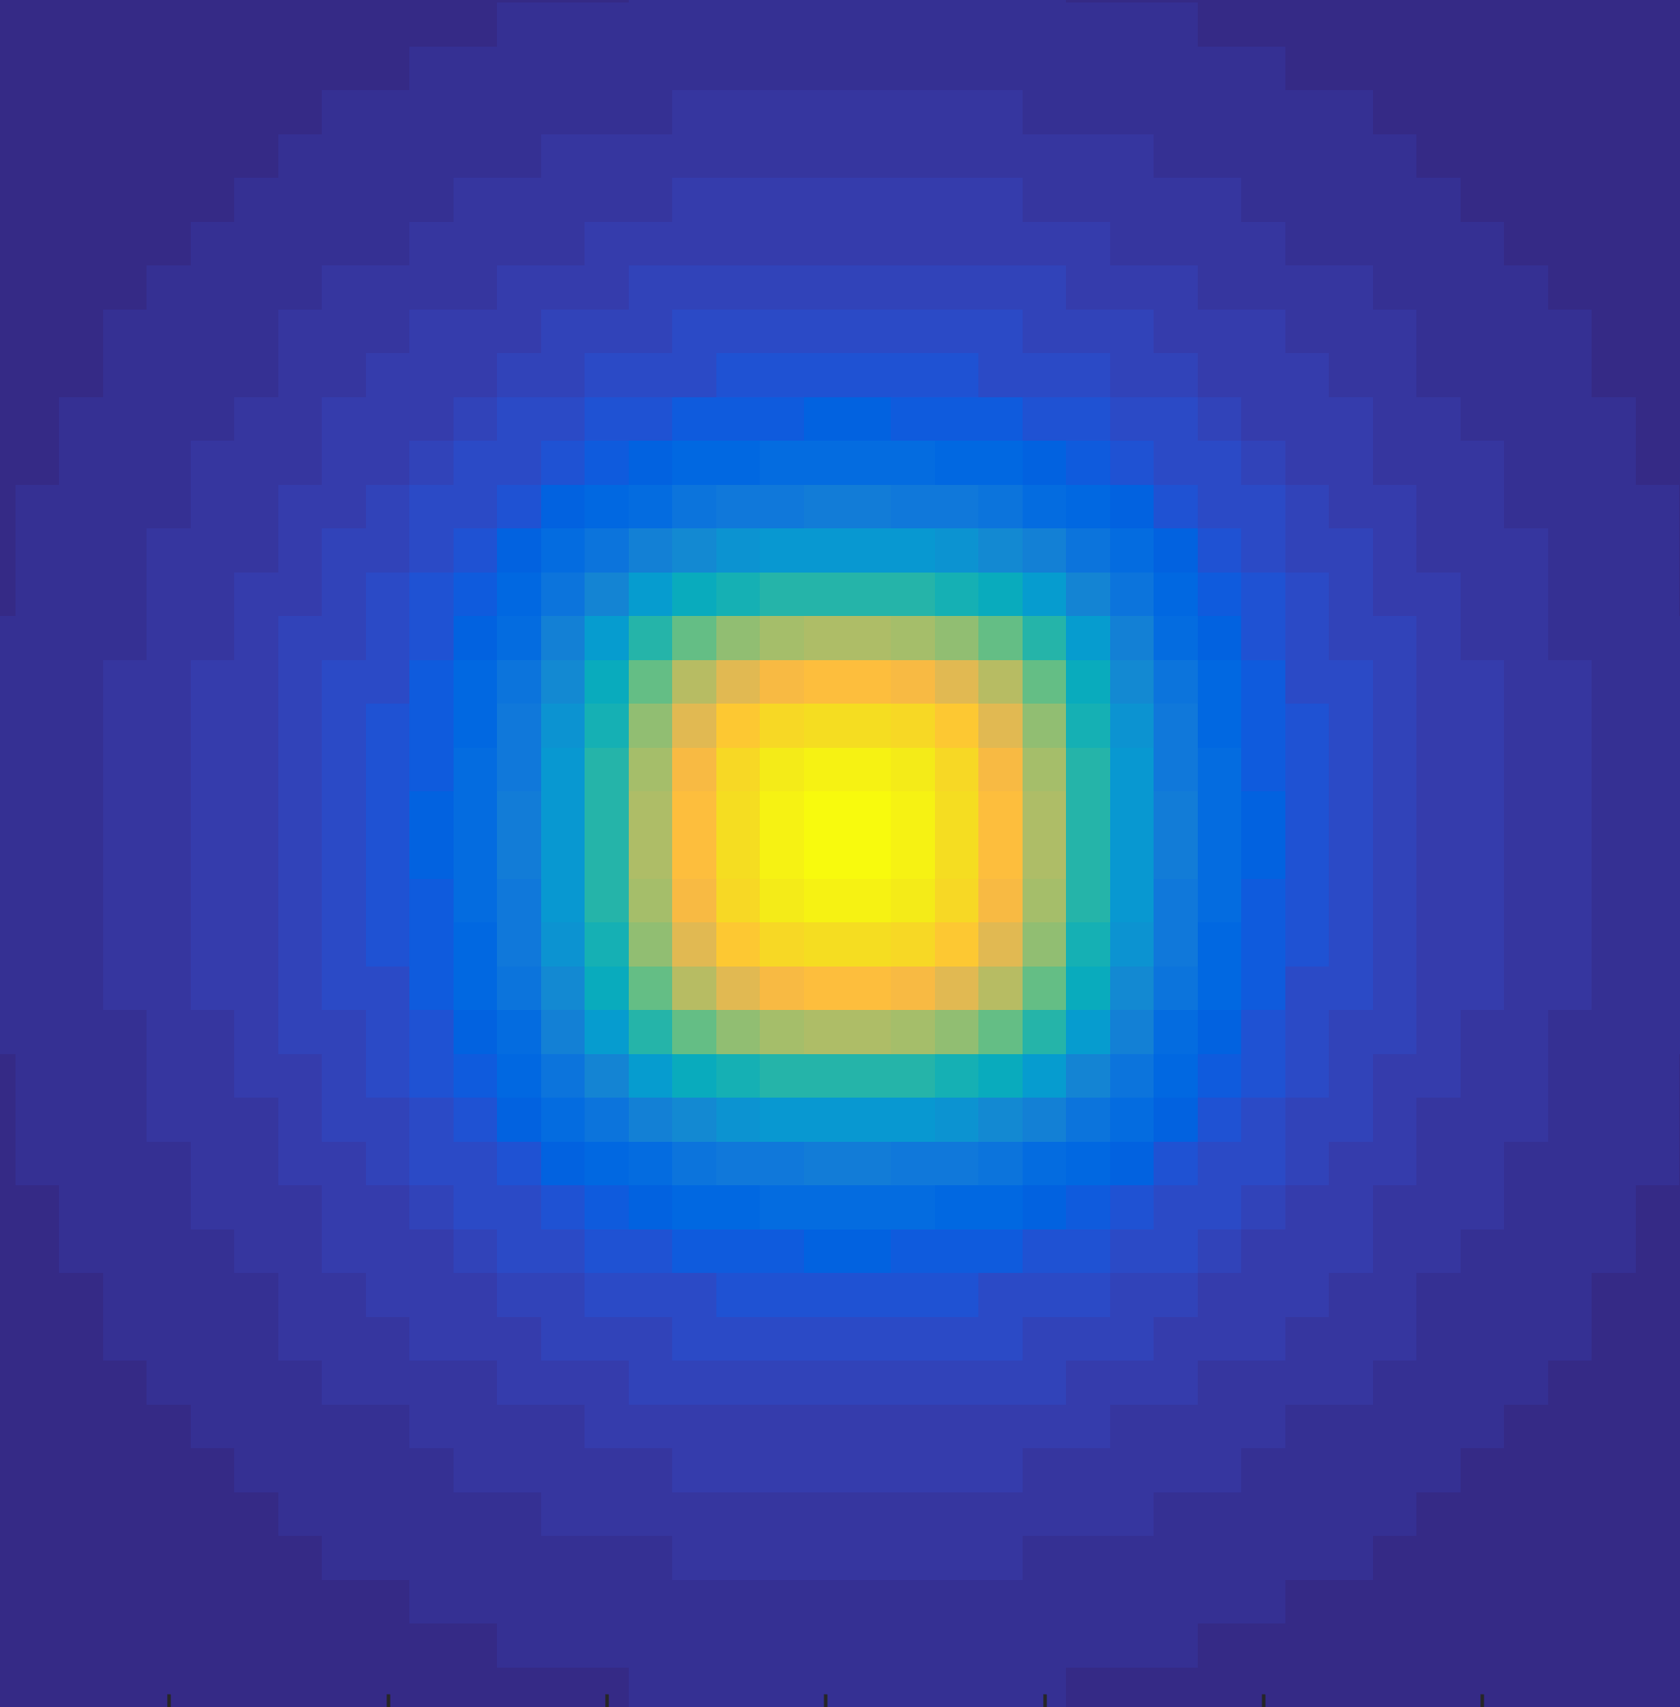
MATLAB code
main_r_1stScatteredFluence.m
Input Constants
Load databases
Define Geometry
Sweep
x,y&z
End
Plot Phantom (3D)
Find Trace
Scatter + Attenuation
Define X-ray

Slide 16
Verification using Monte-Carlo method
AMCcomparison.m
Monte Carlo simulation
Modified Dosxyznrc user code (EGSnrc package)
Load Analytical Result
Spectrum difference
Compare
Load M-C Result
Percentage difference

Slide 17
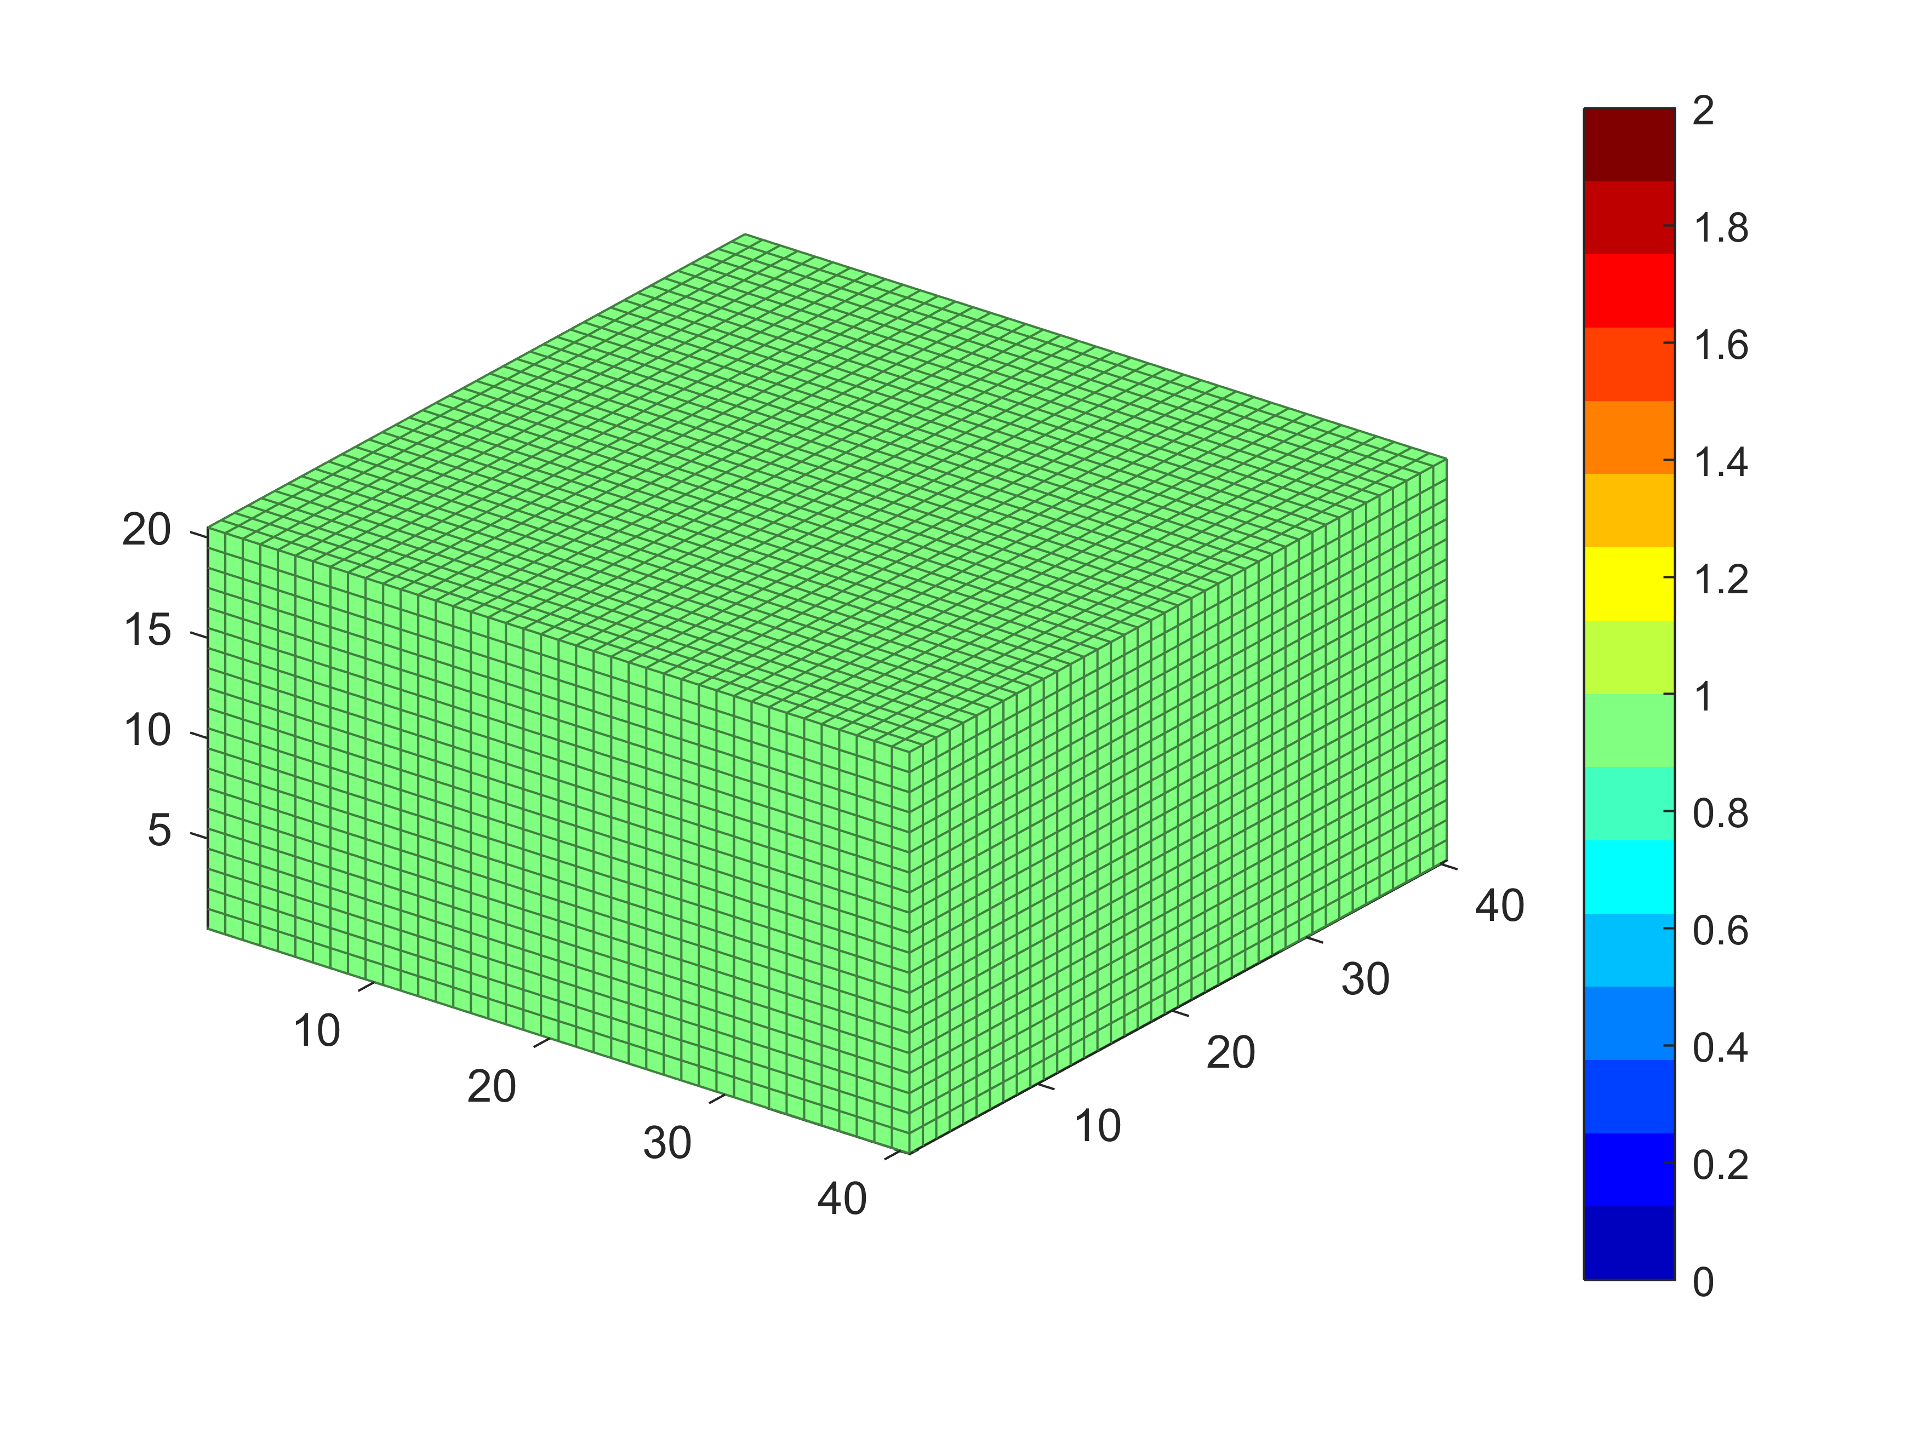
Simulation phantom (Water)

Slide 18

Simulation Results (Water)

Slide 19
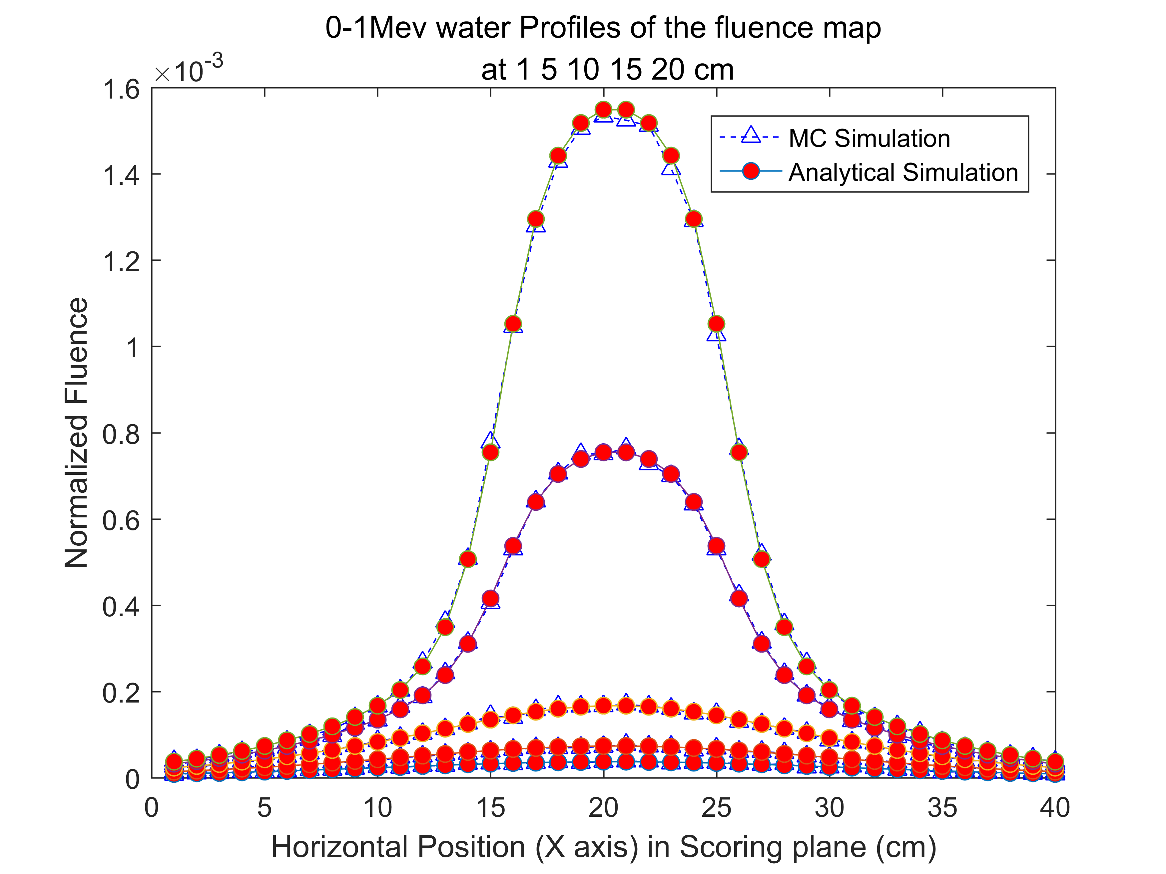
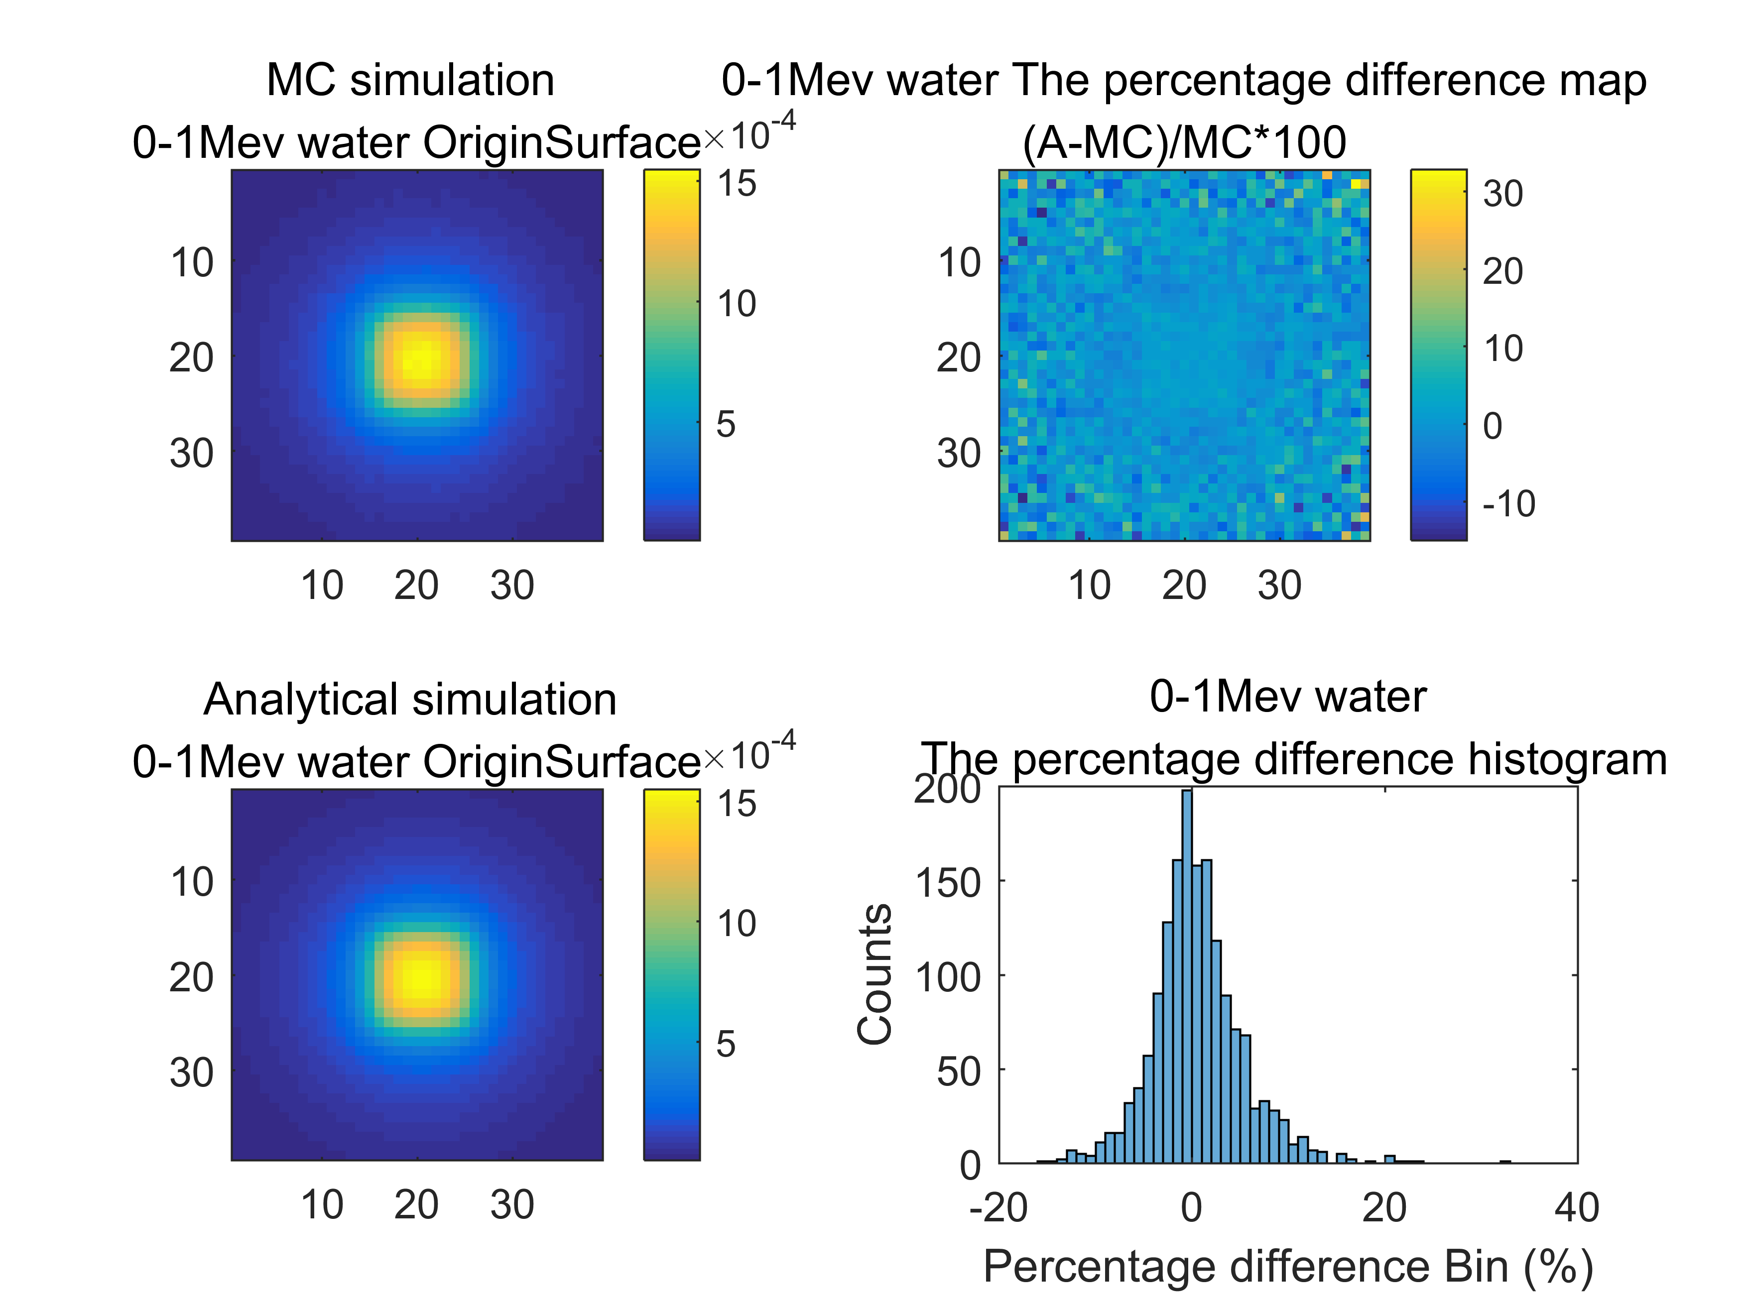
Compare with Monte-Carlo Method
Notes:
Percentage different – normal distribution

Slide 20
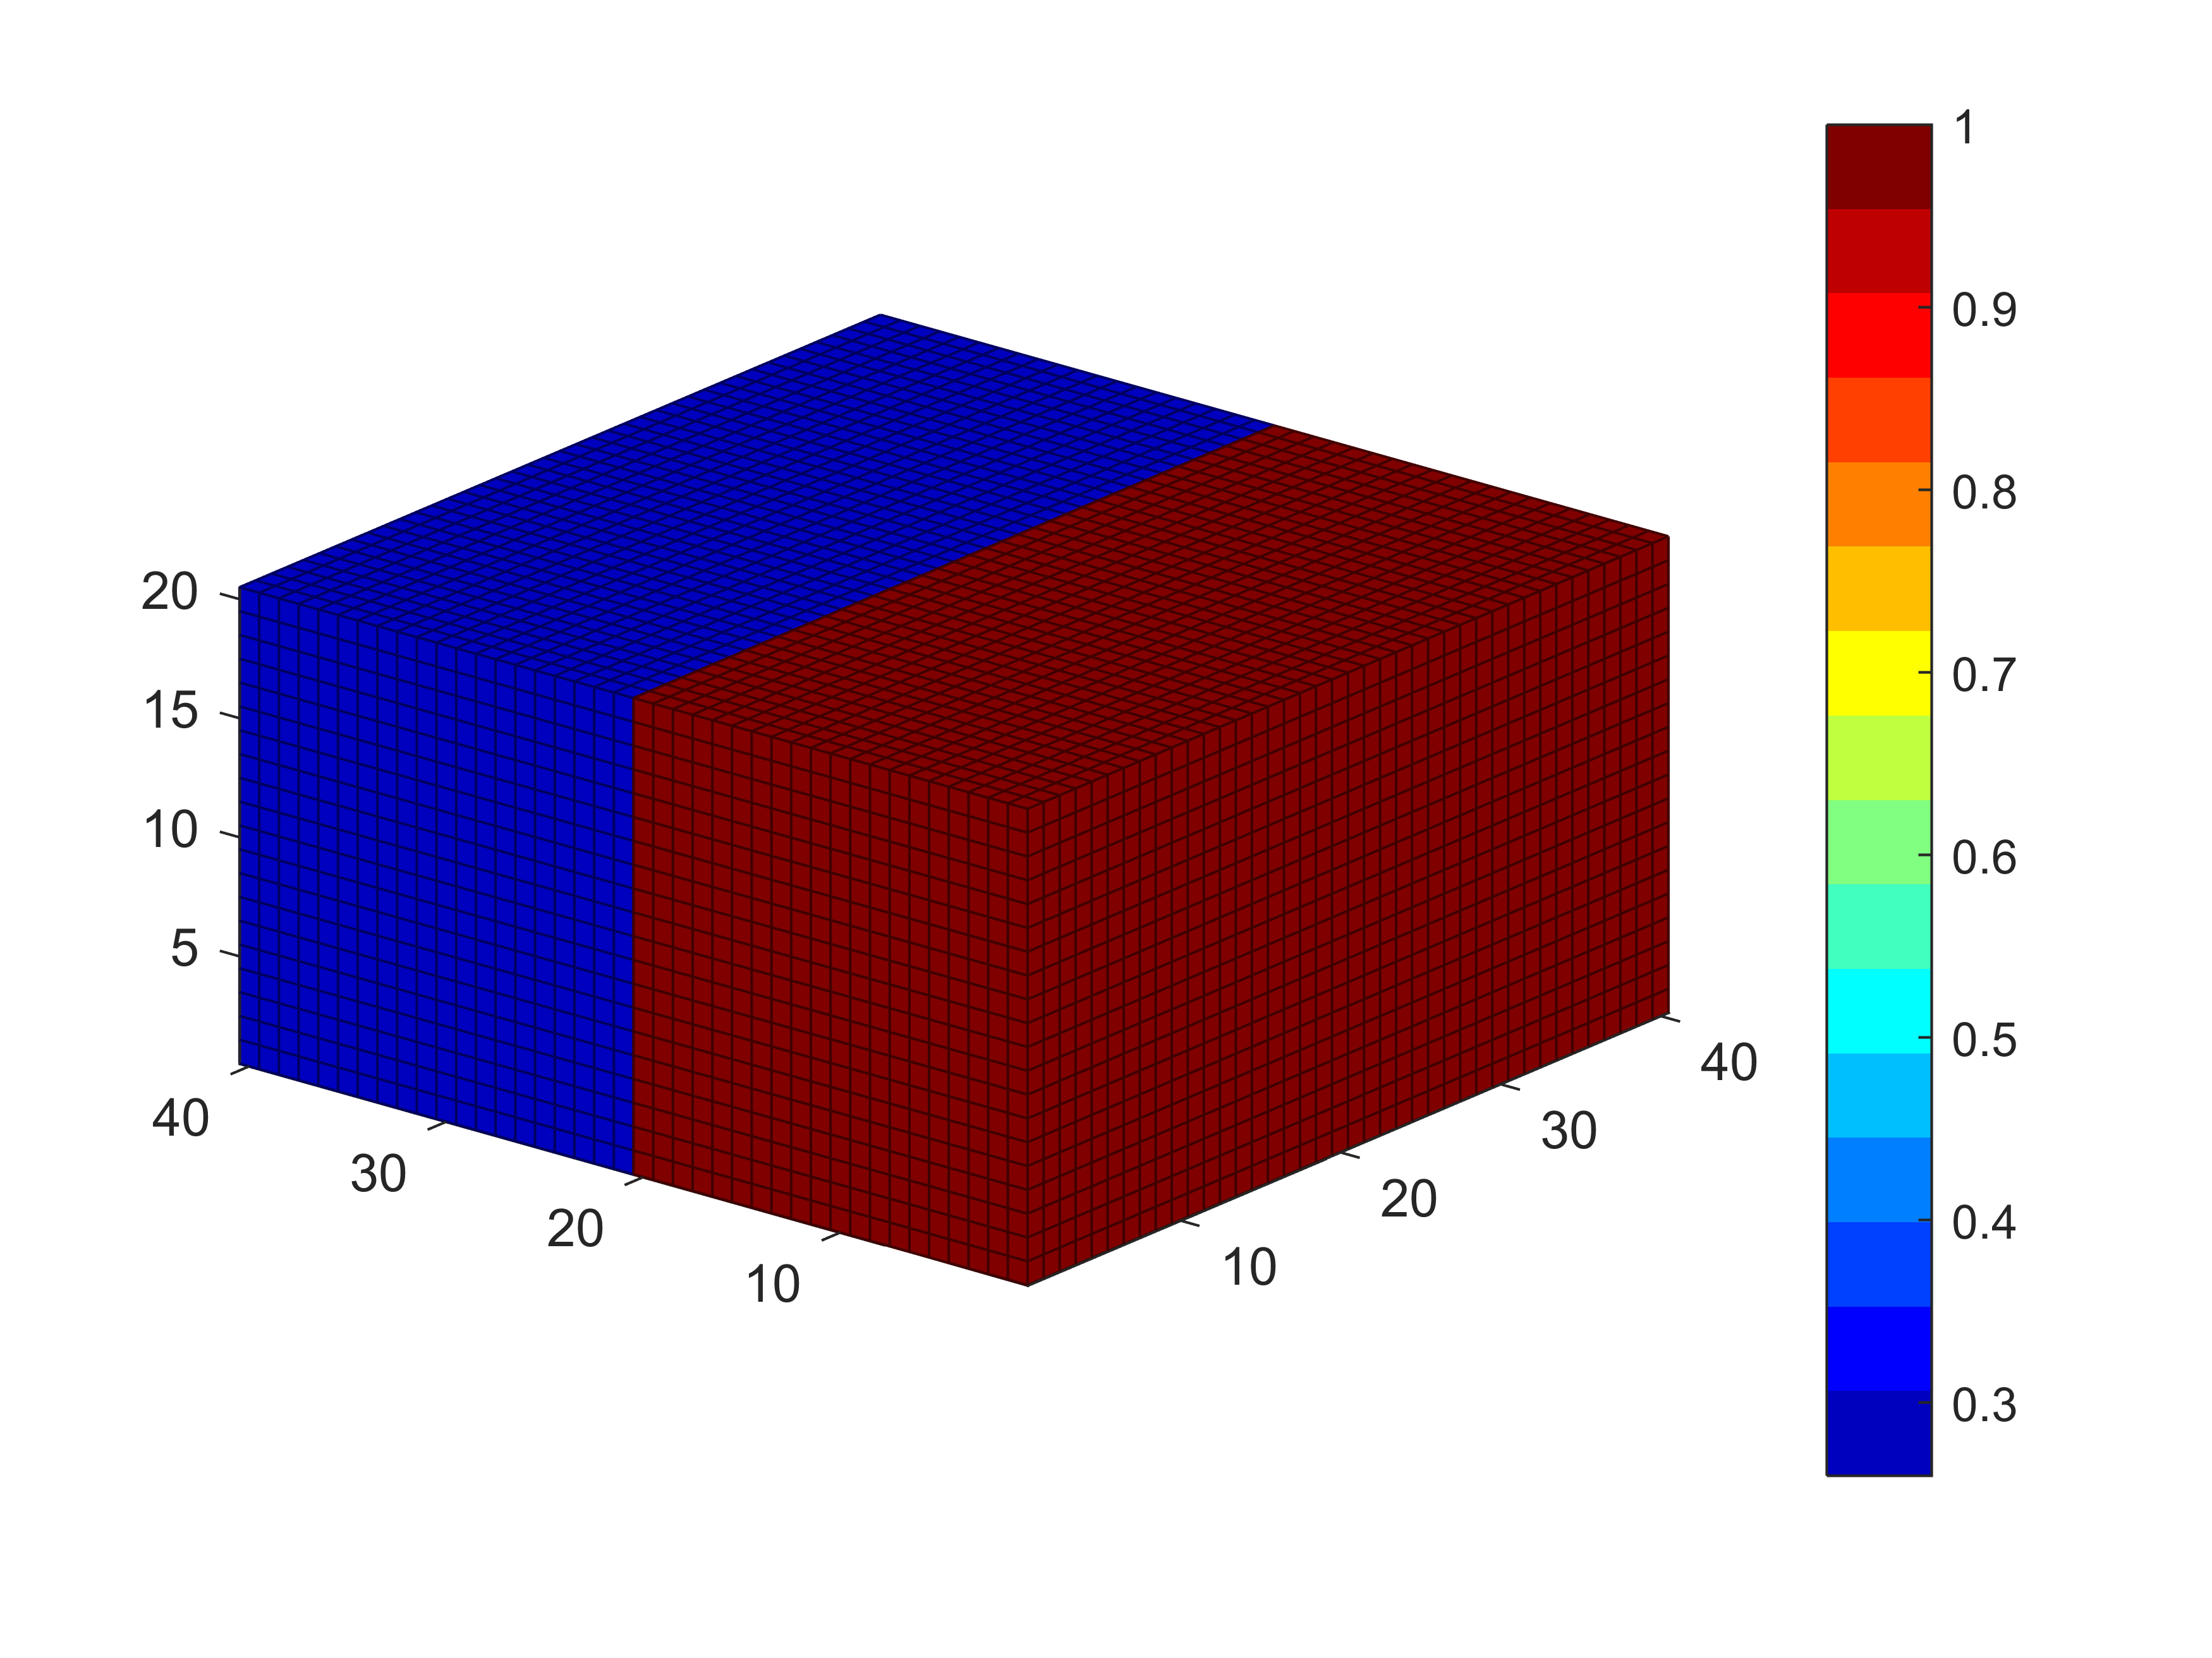
Simulation phantom (half water half lung)

Slide 21
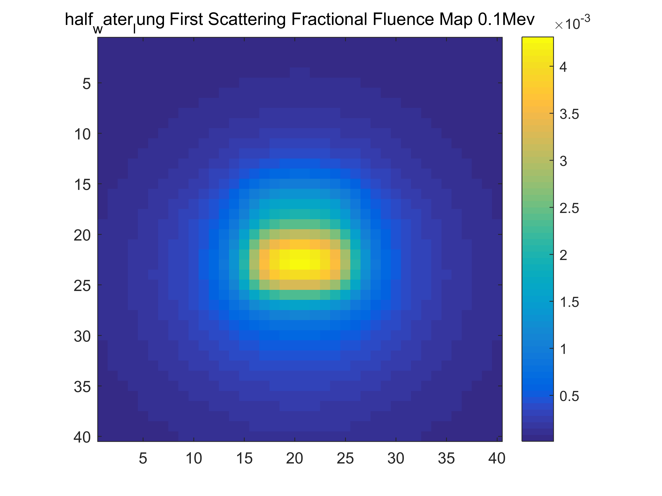
Simulation Results

Slide 22
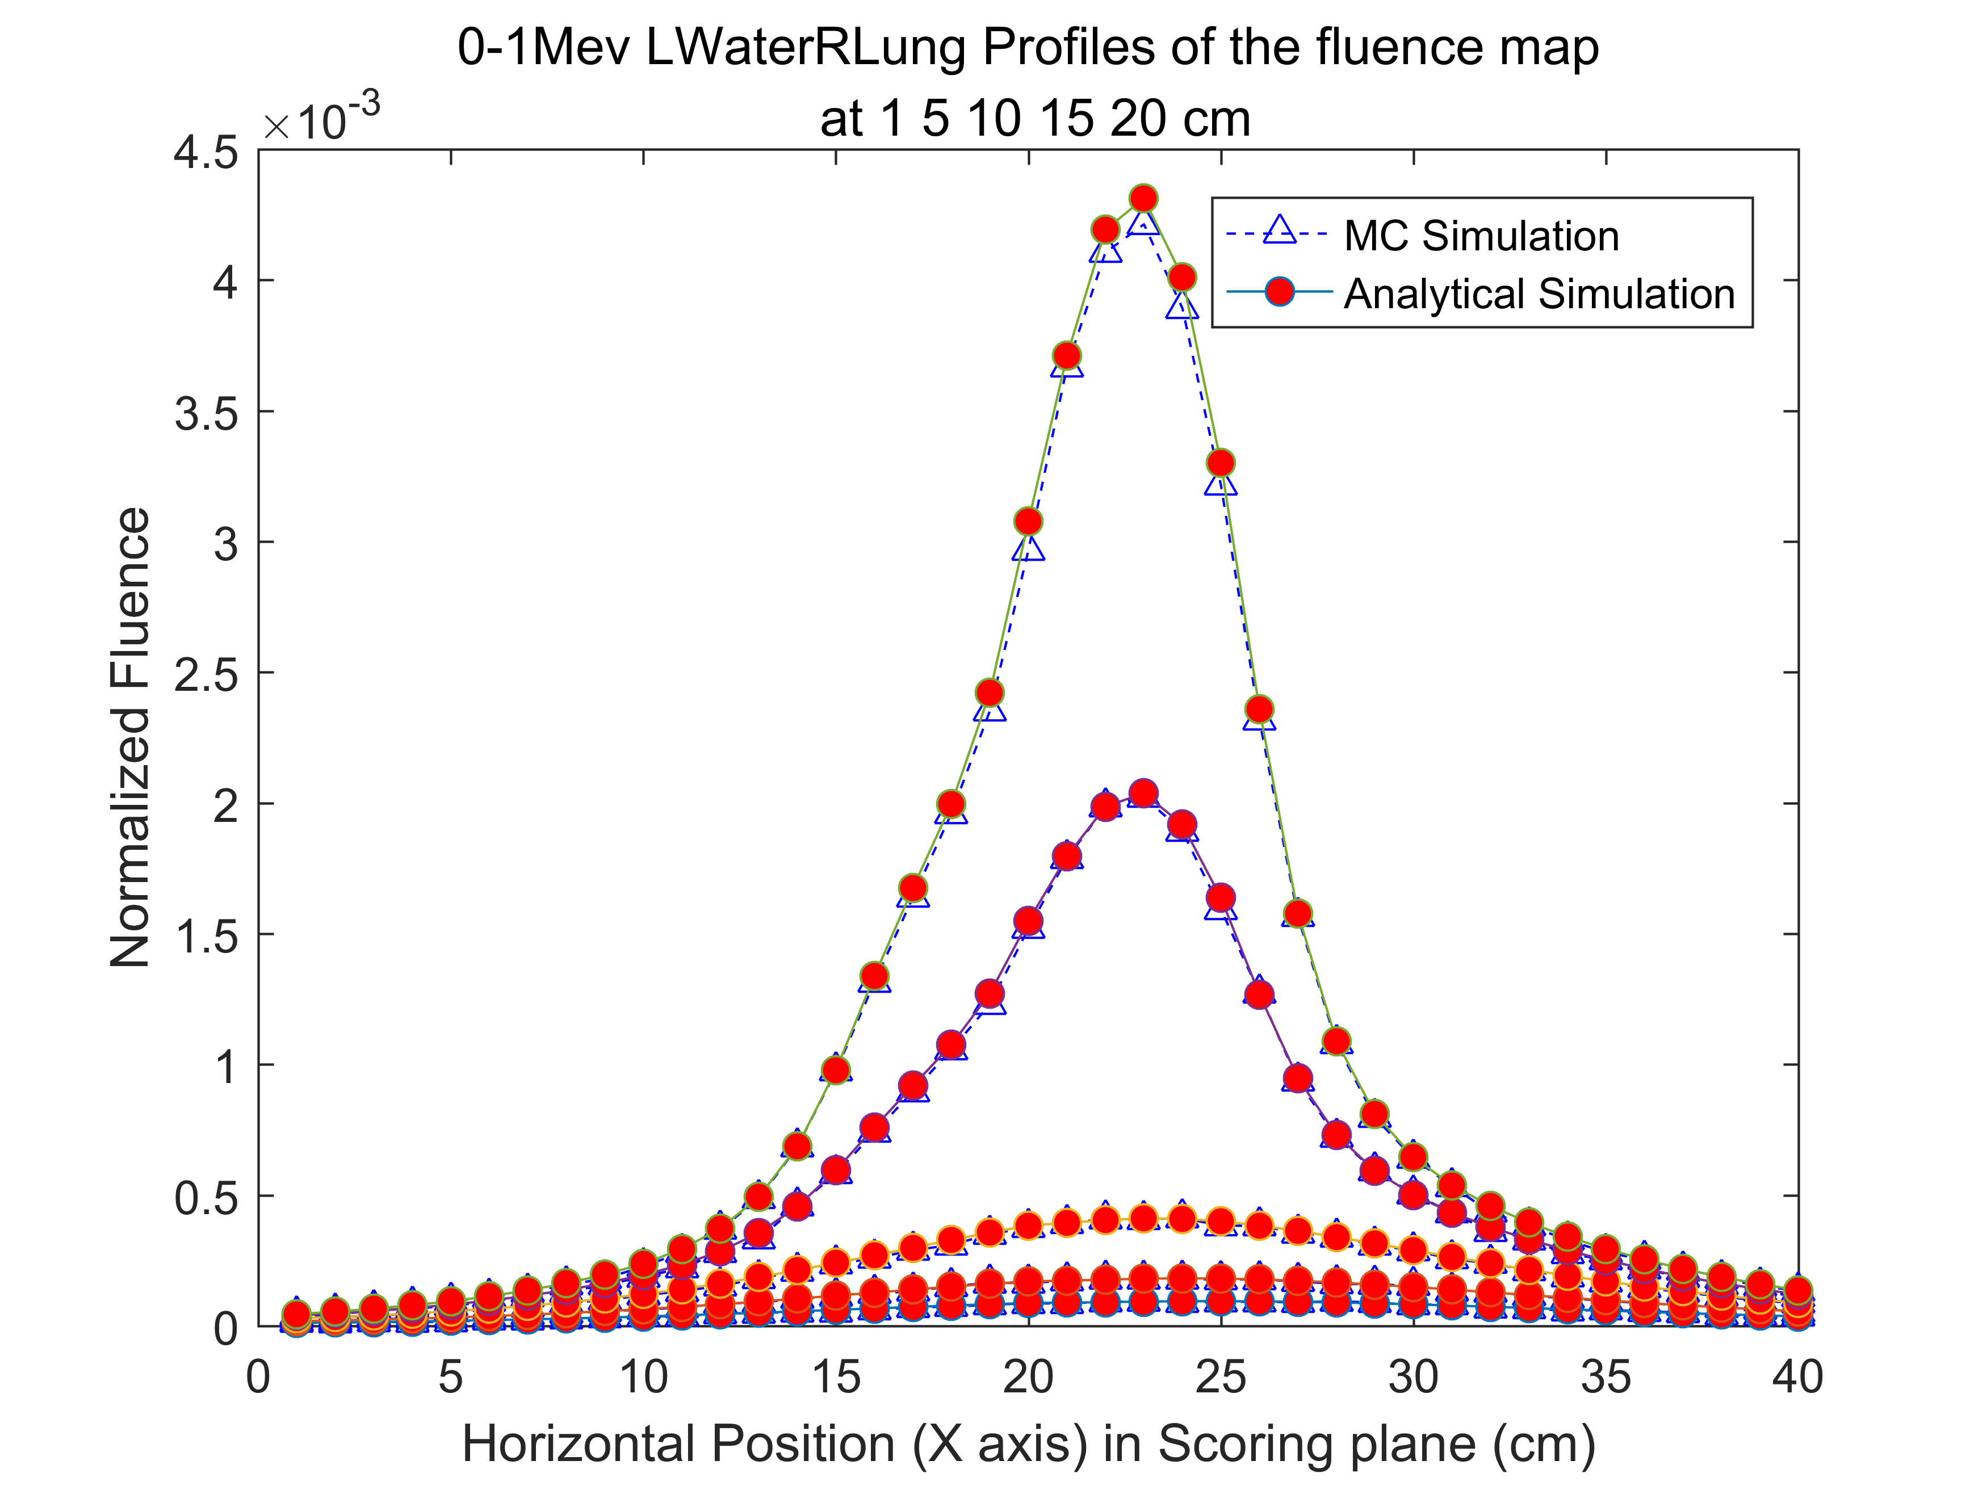
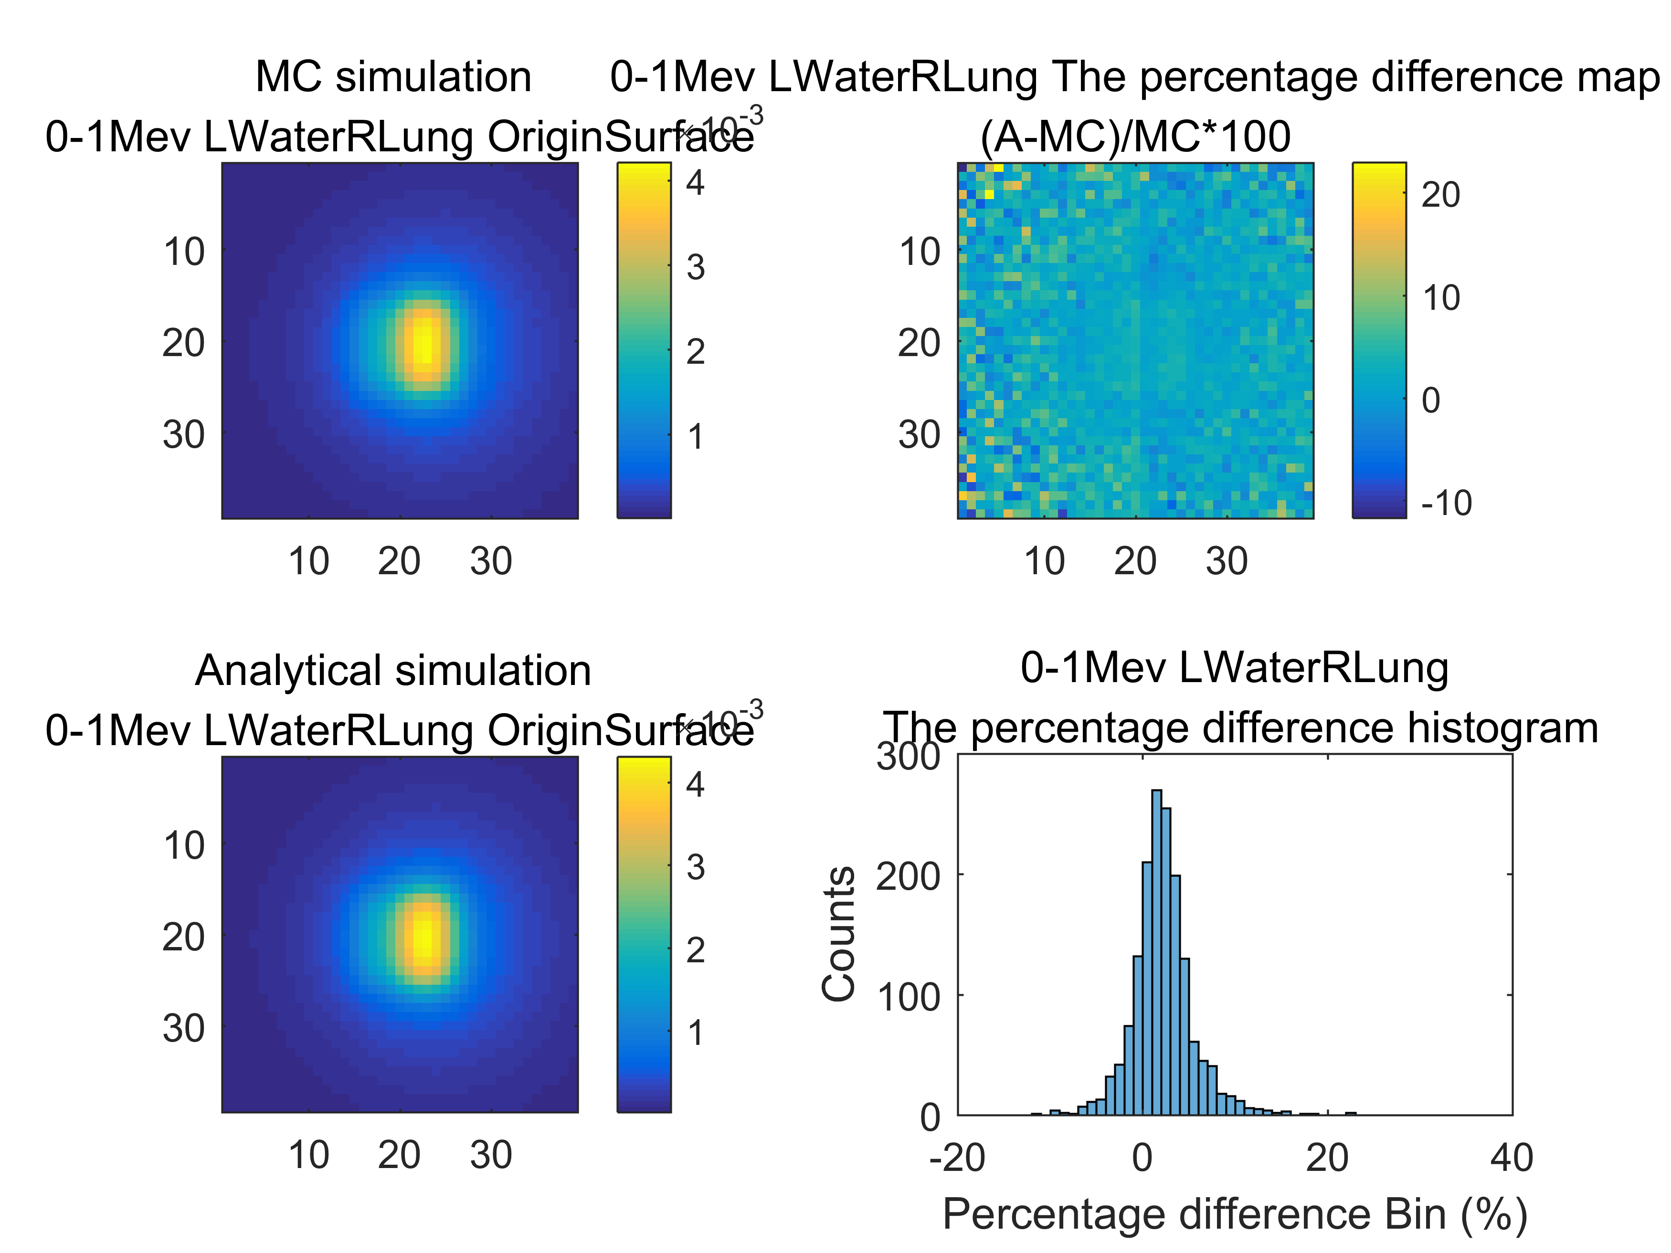
Compare with Monte-Carlo Method

Slide 23
Discussion
Limit 1: We do not have experiment data to validate our results.
Limit 2: The X-ray is parallel. We need to generalize to divergent beam.
Limit 3: Only apply to singly scatter.

Slide 24
Conclusion
1. A reliable analytical method for Rayleigh scattering has been build under parallel beam geometry.
2. Time-saving by utilizing pre-calculations (3.6s compare to 7 hours)
3. Combining with Compton scattering method, the total singly scattered fluence pattern can be obtained.
4. Beneficial to first order scatter correction in CBCT reconstruction

Slide 25
Questions?
Thank you!

Slide 26
Reference
[1] J. H. Siewerdsen and D. A. Jaffray, " Cone-beam computed tomography with a at-panel imager: Magnitude and effects of x-ray scatter," Medical physics, vol. 28, no. 2, pp. 220-231, 2001.
[2]. H. Ingleby, J. Lippuner, D. W. Rickey, Y. Li, and I. Elbakri, "Fast analytical scatter estimation using graphics processing units," Journal of X-ray science and technology, vol. 23, no. 2, pp. 119-133, 2015.
[3]. Hubbell, J. H., Veigele, W. J., Briggs, E. A., Brown, R. T., Cromer, D. T., & Howerton, R. J. "Atomic form factors, incoherent scattering functions, and photon scattering cross sections." Journal of physical and chemical reference data vol.4, no.3 pp.471-538,1975.

Slide 27
Back up pages:

Slide 28
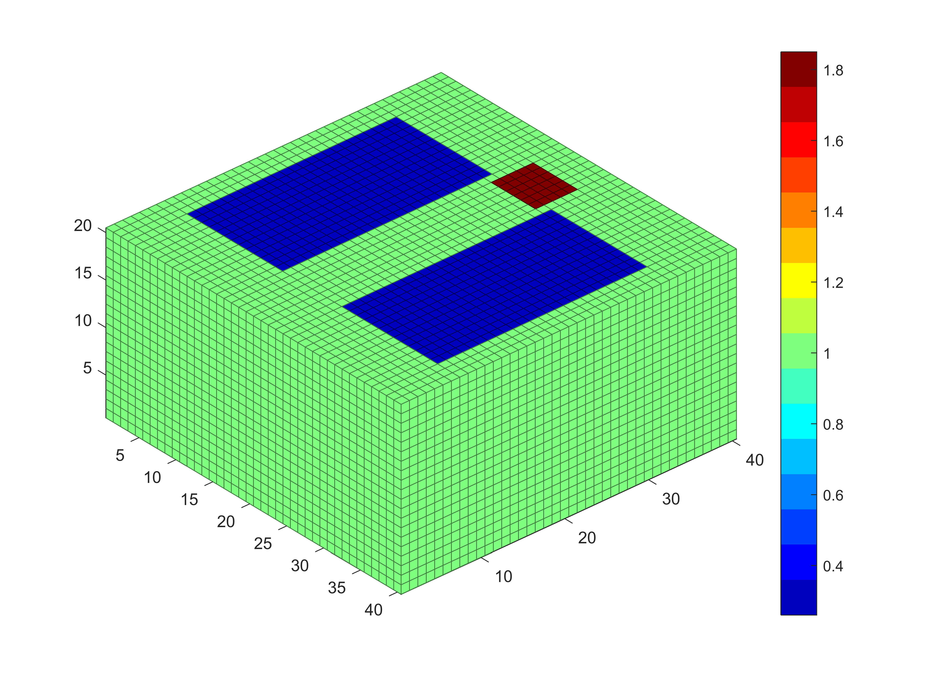
Complex Phantom (human breast)

Slide 29
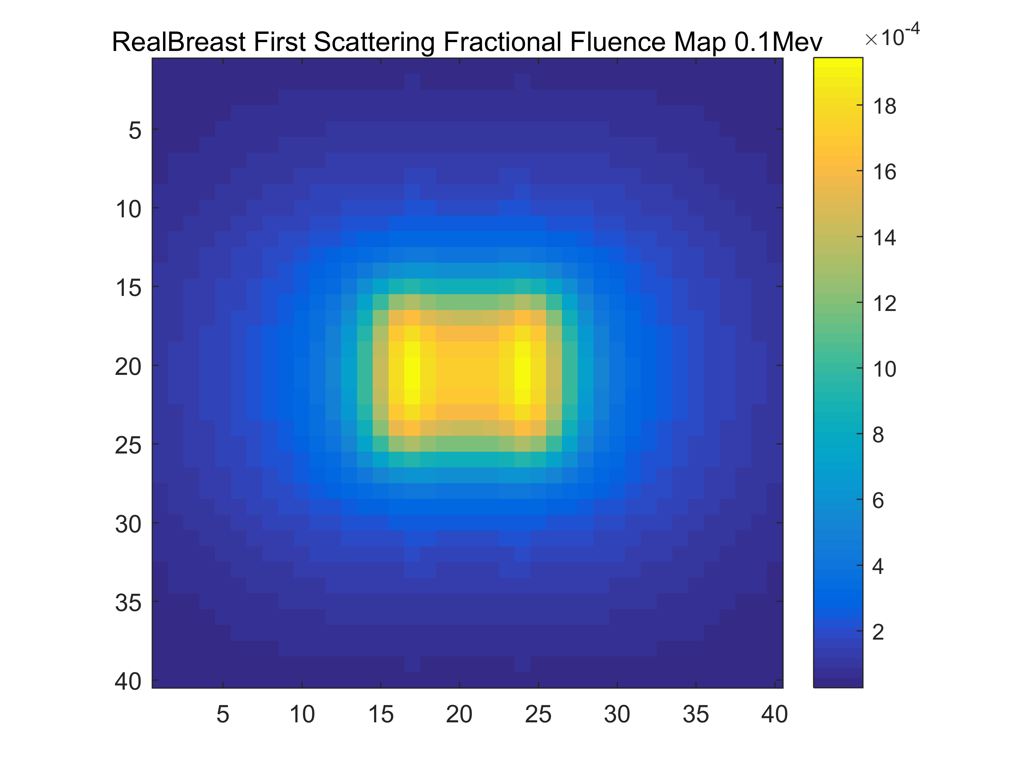
Simulation Results (human breast)

Slide 30
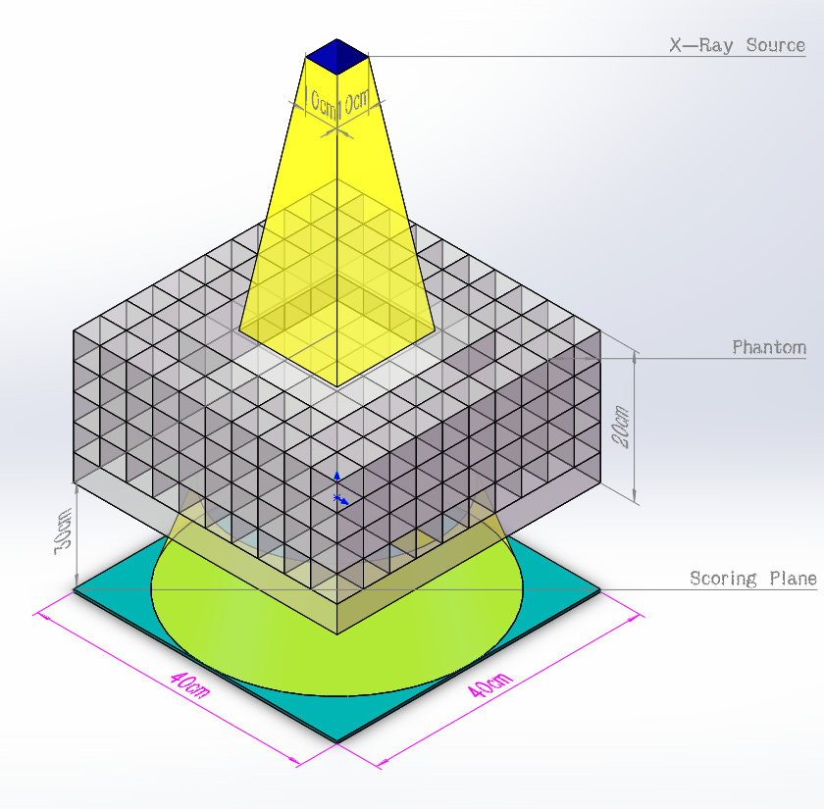
Future work

Slide 31
1st order scatter (Compton & Rayleigh)

Slide 32
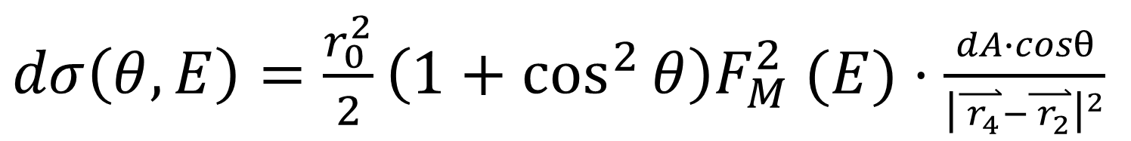
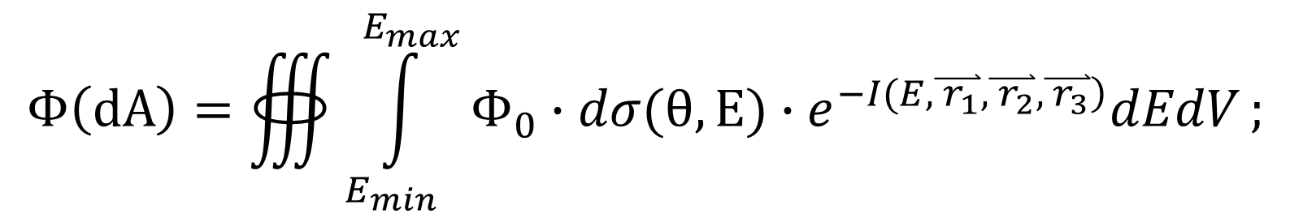
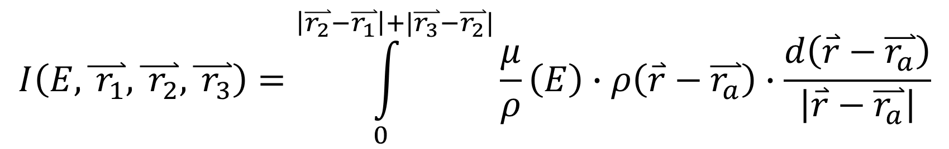
Final Formula:
Total flux :
Cross section:
Radiology pass:
$$Φ\left(dA\right)=∰{\int_{E_{min}}^{E_{max}}{Φ_{0}∙dσ(θ,E)∙e^{\left.−I(E,\overset{⃑}{{ r}_{1}},\overset{⃑}{{ r}_{2}},\overset{⃑}{{ r}_{3}}\right)}dEdV}};$$
$dσ\left(θ,E\right)=\frac{r_{0}^{2}}{2}\left(1+\cos^{2}{θ}\right)F_{M}^{2} (E)⋅\frac{dA∙cosθ}{{\left|\overset{⃑}{{ r}_{4}}−\overset{⃑}{{ r}_{2}}\right|}^{2}}$
$$I\left(E,\overset{⃑}{{ r}_{1}},\overset{⃑}{{ r}_{2}},\overset{⃑}{{ r}_{3}}\right)=\int_{0}^{\left|\overset{⃑}{r_{2}}−\overset{⃑}{r_{1}}\right|+|\overset{⃑}{r_{3}}−\overset{⃑}{r_{2}}|}{\frac{μ}{ρ}\left(E\right)∙ρ\left(\overset{⃑}{r}−\overset{⃑}{r_{a}}\right)∙\frac{d\left(\overset{⃑}{r}−\overset{⃑}{r_{a}}\right)}{\left|\overset{⃑}{r}−\overset{⃑}{r_{a}}\right|}}$$

